Slide 1
SMART WATER MANAGEMENT USING IBM WATSON PLATFORM
By MAP TEAM
B.prashanth reddy
M.Anusha
g.Maheshwari

Slide 2
ABSTRACT
The project Intelligent water distribution system, as the name says it is all about management of water supply throughout the scale, right from small societies, townships to entire urban infrastructure and also for irrigation water supply management. Firstly, we can check the water levels in the tank using ultrasonic sensors and we can check the flow rate of water by using flow sensors and all these data can be sent to cloud and these parameters can be shown on the User Interface which is created in the Node Red.
From user interface we can start and stop the water supply from the main tank to the individual houses. So whenever we start supplying the water we can send notifications to the individuals so that they will be intimated about water supply on time. Notifications are sent through third party services.

Slide 3
BLOCK DIAGRAM
MAIN WATER TANK
NODE MCU
ESP8266
ULTRASONIC SENSOR
FLOW SENSORS
SERVO MOTOR
FLOW RATE NODEMCU
SERVOMOTOR
IBM CLOUD
MIT APP

Slide 4
Hardware
ESP8266(NODE MCU)
Flow Sensor
Servo motor
Ultrasonic sensor
Software
Arduino IDE
IBM Watson Cloud platform

Slide 5
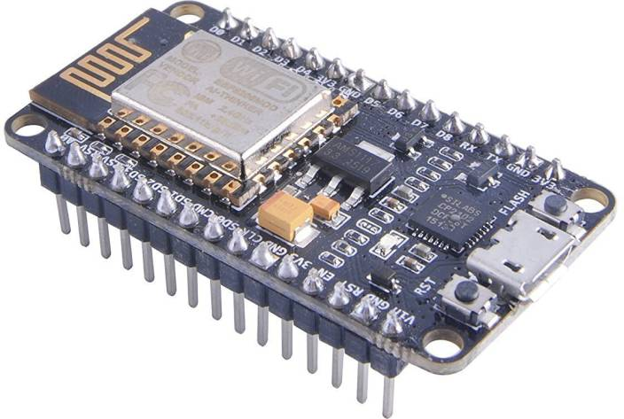
HARDWARE
NodeMCU:
It is an open-source firmware and development kit that plays a vital role in designing your own IoT product using a few Lua script lines.
The module is mainly based on ESP8266 that is a low-cost Wi-Fi microchip incorporating both a full TCP/IP stack and microcontroller capability. It is introduced by manufacturer Espressif Systems – A manufacturer based in Shanghai, China.

Slide 6
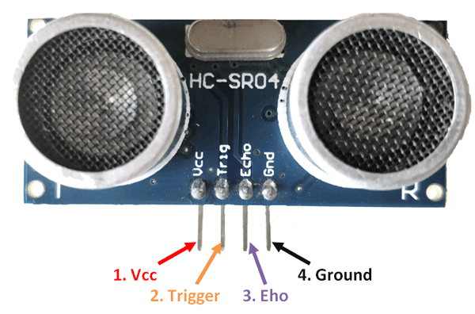
Ultrasonic sensor:
The Ultrasonic transmitter transmits an ultrasonic wave, this wave travels in air and when it gets objected by any material it gets reflected back toward the sensor this reflected wave is observed by the Ultrasonic receiver module

Slide 7
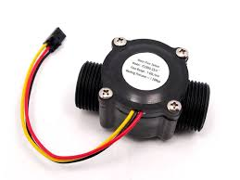
Flow sensor:
Flow sensors typically output a series of pulses proportional to the instantaneous flow rate which means that to interpret them it is necessary to implement a simple frequency counter.

Slide 8
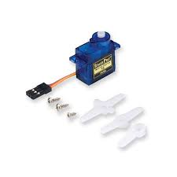
Servo motor:
A servo motor is a closed-loop system that uses position feedback to control its motion and final position.

Slide 9

Software
Arduino:
Arduino is an open-source electronics platform based on easy-to-use hardware and software. Arduino boards are able to read inputs - light on a sensor, a finger on a button, or a Twitter message - and turn it into an output - activating a motor, turning on an LED, publishing something online

Slide 10

IBM Watson cloud platform:
Watson is a question answering computer system capable of answering questions posed in natural language developed in IBM's DeepQA project by a research team led by principal investigator David Ferrucci Watson was named after IBM's first CEO, industrialist Thomas J. Watson.

Slide 11

MIT App Inventor:
It is an intuitive, visual programming environment that allows everyone – even children – to build fully functional apps for smartphones and tablets. Those new to MIT App Inventor can have a simple first app up and running in less than 30 minutes. Blocks-based coding programs inspire intellectual and creative empowerment.

Slide 12
DESCRIPTION
Firstly, we can check the water levels in the tank using ultrasonic sensors and based on water levels we can start and stop the water supply from the main tank to the individual houses automatically.
And later at the house level we can check the flow rate of water by using flow sensors and all these data can be sent to cloud and these parameters can be shown on the User Interface which is created in the Node Red.
From user interface/App, based on flowrate value from the Flow Sensor we provide individuals whether the tap in the room has to be on/off so that they will be able to store the water in home without manual interaction even when they are not present in home.

Slide 13
THANK YOU

